Slide 1
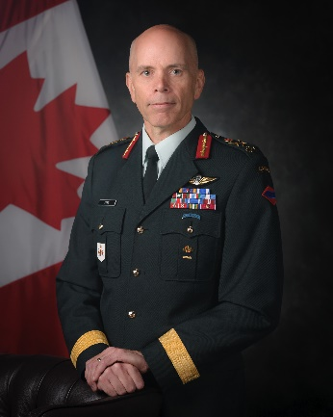
Commander Canadian Army – LGen Wayne Eyre, MSC, CD
UNCLASSIFIED
Appointed 20 August 2019, 35 years of service
Experience as an embedded senior leader with the United Nations, NATO and the US Army’s prestigious XVIII Airborne Corps
Commanded forces in Cyprus, Croatia, Bosnia, Afghanistan, and South Korea
First non-American Deputy Commander of the United Nations Command in South Korea
Was a key contributor of the human resources portions of the defence policy, Strong, Secure, Engaged.
MANDATE
As part of the Canadian Armed Forces, the Canadian Army force generates land capabilities for the achievement of Canadian defence objectives across the full spectrum of operations
Work alongside whole-of-government, whole-of-nation colleagues, non-governmental agencies and international partners
Commander Canadian Army is the Departmental Champion for Indigenous Peoples. The Army promotes engagement with Indigenous communities through a variety of programs, such as summer programs for Indigenous youth
KEY FACTS
The Army consists of:
23,000 Regular Force
19,000 Army Reserve
5,200 Canadian Rangers
3,300 Civilians
Budget:
$935M Operating Budget (Fiscal Year 19-20)
Allocation of Capital Project Funding
$17.8B for Army equipment projects over the next 20 years (managed by ADM (Materiel)
Primary location(s):
11 Army Bases and 169 Armouries in 117 communities across Canada
185 Ranger patrols in over 200 remote communities
1150 personnel currently (31 July 2019) on expeditionary operations (Eastern Europe, Africa, Iraq/Kuwait, etc.)
KEY PARTNERS
Internal:
Vice Chief of Defence Staff
Royal Canadian Navy, Royal Canadian Airforce
Canadian Special Operations Forces Command
Strategic Joint Staff
Canadian Joint Operations Command
Chief Military Personnel
Assistant Deputy Minister (Infrastructure and Environment)
Assistant Deputy Minister (Materiel)
Assistant Deputy Minister (Finance)
Assistant Deputy Minister (Science and Technology)
Defence Research and Development Canada
External: (including other government departments)
North Atlantic Treaty Organization
US, Australian, British, and New Zealand Armies
Public Safety
Veterans Affairs Canada
Law enforcement (federal, provincial, municipal)
Local communities (through bases and Reserve units); service clubs
Post Secondary Institutions
Top issues FOR THE CANADIAN ARMY
Posturing for Concurrency of Operations
Conduct a thorough review of the system we use to ensure committed elements of the Army are ready for domestic and international tasks
Maintain the level of training in basic warfighting skills across the Army
Reinforce the leadership skills of our emerging leaders with the skillsets that allow us to adapt to the ever-changing security environment
Strengthening the Army by Operationalizing the Army Reserve
Grow the Army Reserve by reducing hiring times from more than 90 days to less than 30 days
Continue to provide Full Time Summer Employment for the first four years of Army Reserve service (7,200 in 2018, projected 9,000 in 2019)
Continue to assign Army Reserve units enhanced roles to provide full time capabilities through part time service
Total Health of the Force
Develop soldiers’ resilience (physical, emotional, social, spiritual, intellectual and family health)
Take swift and judicious action to stamp out inappropriate behaviour
Promote diversity and integration, ensuring we optimize effectiveness and attract the best talent from across Canadian society
Raise awareness of the rich tradition experience, and contribution of our Indigenous Peoples
Managing Capability Gaps and
Introducing New Capabilities
Work with stakeholders to deliver the Army’s portion of the Capital Program
52 major projects to be implemented by 2025
Ensure interoperability of our capabilities with our key partners
Continue to adopt business analytics to enhance decision making

